Slide 1
Surefire Growth Strategies
For POS Resellers
Jim Roddy, Reseller & ISV Business Advisor
Vantiv PaymentsEdge Advisory Services
Notes:
WEBINAR (45 minutes)
Surefire Growth Strategies For POS Resellers
What do fast-growth point of sale resellers know that you don’t? They’ve developed a winning formula for perpetually increasing sales and providing superior customer value. Vantiv’s Jim Roddy has engaged with these leading resellers during his 18 years in the POS channel, and in this talk he will share with you the principles and best practices that will spark growth at your organization. You’ll leave this session fired up and ready to take on the challenge of growing your business in a rapidly changing industry!
Let me start by telling you a quick story about the happiest audience in the history of all presentations …
Oprah 2004 – You get a car, everybody gets a car
Get it out of your head …
But if you participate in this exercise & follow best practices …
Grow your company
Buy yourself many cars

Slide 2
Surefire Growth Strategies For POS Resellers
PaymentsEdge Advisory Services
Notes:
Hypothetical $10,000
My colleagues at Vantiv …
Investment money

Slide 3
Surefire Growth Strategies For POS Resellers
PaymentsEdge Advisory Services
California
Ramping up sales force: Hiring Director of Sales and Marketing, equity plan, improve marketing and sales operations, hire sales team
Adding new products/services: POS and payments, adding security and managed services
Entering new markets: No, 100% focus on grocery
Aggressive marketing: “Our website is pathetic”, no social media

Slide 4
Surefire Growth Strategies For POS Resellers
PaymentsEdge Advisory Services
Indiana
Ramping up sales force: No; “just me and one full-time tech”, holding on to 50 home furnishings customers, “trying to hold my own but I’m in a decline – I’m stuck”
Adding new products/services: No, sells only refurbished hardware and retail software
Entering new markets: No, staying in local furnishings
Aggressive marketing: “They find me. I don’t market.”

Slide 5
Surefire Growth Strategies For POS Resellers
PaymentsEdge Advisory Services
Texas
Ramping up sales force: Owner does all sales, lead tech moved out of town, hiring an ops manager/lead tech, then a sales rep who will shadow the owner
Adding new products/services: Longtime POS and payments; expanding into security, A/V, networking, VoIP, and full managed services including RMM
Entering new markets: Health food, added pharmacies
Aggressive marketing: “As much as I can by myself.”

Slide 6
Surefire Growth Strategies For POS Resellers
PaymentsEdge Advisory Services
California
Indiana
Texas
Notes:
Where will you invest your $10,000?
Can split
If you know how you want to split, please enter in the Q&A box
* CA 5, IN 3, TX 2
Quick review …

Slide 7
Surefire Growth Strategies For POS Resellers
PaymentsEdge Advisory Services
California
Ramping up sales force: Hiring Director of Sales and Marketing, equity plan, improve marketing and sales operations, hire sales team
Adding new products/services: POS and payments, adding security and managed services
Entering new markets: No, 100% focus on grocery
Aggressive marketing: “Our website is pathetic”, no social media

Slide 8
Surefire Growth Strategies For POS Resellers
PaymentsEdge Advisory Services
Indiana
Ramping up sales force: No; “just me and one full-time tech”, holding on to 50 home furnishings customers, “trying to hold my own but I’m in a decline – I’m stuck”
Adding new products/services: No, sells only refurbished hardware and retail software
Entering new markets: No, staying in local furnishings
Aggressive marketing: “They find me. I don’t market.”

Slide 9
Surefire Growth Strategies For POS Resellers
PaymentsEdge Advisory Services
Texas
Ramping up sales force: Owner does all sales, lead tech moved out of town, hiring an ops manager/lead tech, then a sales rep who will shadow the owner
Adding new products/services: Longtime POS and payments; expanding into security, A/V, networking, VoIP, and full managed services including RMM
Entering new markets: Health food, added pharmacies
Aggressive marketing: “As much as I can by myself.”

Slide 10
Surefire Growth Strategies For POS Resellers
PaymentsEdge Advisory Services
California
Indiana
Texas
Notes:
Write down where you will invest your $10,000?
Can split
Who wants to share? / Let’s see the results
Anyone invest most of their money in Indiana?
Hypothetical reseller in a hypothetical state …

Slide 11
Surefire Growth Strategies For POS Resellers
PaymentsEdge Advisory Services
New Carolina
Ramping up an outbound sales force: Motivated manager and sales team, built a strong operational infrastructure, measure and audit performance-based activities through automation (PSA)
Adding new products and services: “Total Solution Provider,” POS, payment processing, data and payment security, networking, and managed services through RMM
Entering new markets: Grocery experts, expanding geography
Outspending the competition on marketing: SEO-rich website, educational content, prospect touches every 3 weeks
Notes:
Notice anything here?
* Nova Scotia flag: correct but missing the point
* Should be sensing a theme here

Slide 12
Surefire Growth Strategies For POS Resellers
PaymentsEdge Advisory Services
Reseller Growth Strategies
1. Ramp up an outbound sales force
2. Add new products and services
3. Enter new markets
4. Outspend the competition on marketing
Notes:
Get out of the day to day, step back from your business

Slide 13
Surefire Growth Strategies For POS Resellers
PaymentsEdge Advisory Services
Ramp up an outbound sales force
8 Time-Tested Rules For Hiring & Retaining Salespeople
(Rule 6 Almost Started A Fistfight)
Notes:
Baseball - very difficult. Never perfect.
Sales trickiest.
Won’t make you perfect.
Learn proven successful process … exponentially reduce … hires even better.

Slide 14
Surefire Growth Strategies For POS Resellers
PaymentsEdge Advisory Services
Ramp up an outbound sales force
1. Raise Your Standards
2. Fire Your Lousy Salespeople
3. Sit Down & Write a Training Plan
4. Don’t Get Hypnotized By A Resume
Notes:
#1: Capable salespeople … successful, fun, and have high character … exist.
Hold out
Typical hiring manager error –skills, resume
Determine … four areas: skills, personality, character, AND mapping
#2 Right culture before hiring
Give underperforming chance.
Not quarters, not years … months
Iceberg
Systems … view
Reports – sales and productivity
PSA software – Jason 100 points story
#3 Good To Great, Jim Collins … “rigorous discipline.” [type 3]
Thorough plan
Book Execution: “Execution … aspirations and results”
Nobody Microsoft, Apple, Google
Specific and reasonably detailed
“I do, we do, you do.”
#4 Likeable, well-spoken … boasts
S, P, C, M
Mistake … can sell.
Failures: Lanny (LarryL), Terrance (TonyS)
Wins: Lucas, Tim U, Tracy

Slide 15
Surefire Growth Strategies For POS Resellers
PaymentsEdge Advisory Services
Ramp up an outbound sales force
5. Test, Don’t Guess
6. Challenge Them
7. Slow Down, You Move Too Fast
8. Set Clear Expectations
Notes:
#5 “I’m a gonna …”
X decision … promises.
Predictor … politician.
Your past sales hires!
Test we use
Wonderlic, DISC
Essay
Dinner – spittoon
1-for-1 sales tests
#6 Fistfight rule!
Occasionally challenge … react to pressure.
Share criticisms … how they respond.
X accusatory, condescending, or emotionally charged
conversation, not interrogation.
How we do:
Early Q: feel criticism
You said earlier in our interview that you’re OK with criticism. Can I give you some?
I want to share a criticism with you. I hope I don’t come off as harsh here — I’m just trying to make sure this is a right fit for you and us. Can I share with you an area that concerns me?
Direct and succinct … clear criticism, then observe
Near fistfight :
Sales, 6-5, 250, athlete
Pointed out multiple … strayed
Smile scowl … beet red.
Leaned …fists.
Loud …”Who do you think you are?” and “I’ve never been so insulted in my life!”
Hired him?
#7 Typical process – resume, personality … make an offer
Can’t just hang out for an hour and get the information you need.
At its core, the pre-employment process involves getting important information on the table, sorting through it, and making a decision.
Bucket … two buckets … you need a wheelbarrow overflowing with data to draw a clear picture of any candidate.
The more information you can uncover and the more skillfully you analyze it, the better your hiring decision will be.
Sales candidates should spend time with current sales reps – personal interaction, observing sales calls and a sales meeting, listening to calls.
#8 Aversions interview – timing and purpose, no perfect candidate/company
The “Who’s your daddy?” interview.
STUFFR – Set Them Up For Future Reference

Slide 16
Surefire Growth Strategies For POS Resellers
PaymentsEdge Advisory Services
Notes:
Paperback and e-book: Amazon, BN, HLYJBC.com
Many more resources at the website

Slide 17
Surefire Growth Strategies For POS Resellers
PaymentsEdge Advisory Services
Add new products and services
Recurring Revenue Services
Payment processing
Remote monitoring
Wireless device management
Network management
Firewall management
Remote access
Gift/loyalty
Application white listing service
Chris Rumpf
Notes:
Chris Rumpf story

Slide 18
Surefire Growth Strategies For POS Resellers
PaymentsEdge Advisory Services
Add new products and services
Recurring Revenue Services
Payment processing
Remote monitoring
Wireless device management
Network management
Firewall management
Remote access
Gift/loyalty
Application white listing service
Chris Rumpf
(and friend)
Notes:
Look how happy!

Slide 19
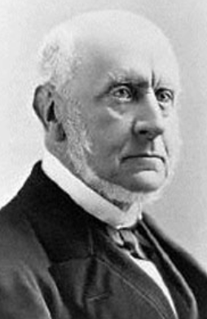
Surefire Growth Strategies For POS Resellers
PaymentsEdge Advisory Services
Enter new markets
“Surveying the whole field of business, I fixed on the most developing force and the largest field of the day, and determined to attach myself to it.”
Charles Francis Adams 1840
Notes:
Won’t dictate market to you
Who gave this advice – Bill Gates? Steve Jobs? Larry Page from Google?
Refer to Indiana reseller
Surfing

Slide 20
Surefire Growth Strategies For POS Resellers
PaymentsEdge Advisory Services
Outspend the competition on marketing
Commercial Teaching
Content Marketing
“Secrets To A Candid Work Culture”
Notes:
Resources
Commercial Teaching – have something to market
“Teach them something new about how their company can compete more effectively.” Challenger Sale
High level with customers: Challenger Sale
Example: Mercury call with Tim and Joe
Reseller example – grocery expert
Content Marketing → next slide
Auto-Star partner RMS (Retail Management Solutions) blog

Slide 21
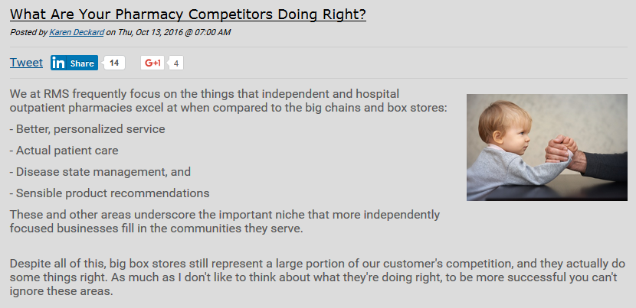
Surefire Growth Strategies For POS Resellers
PaymentsEdge Advisory Services
Content Marketing
Notes:
Auto-Star partner RMS (Retail Management Solutions) blog

Slide 22
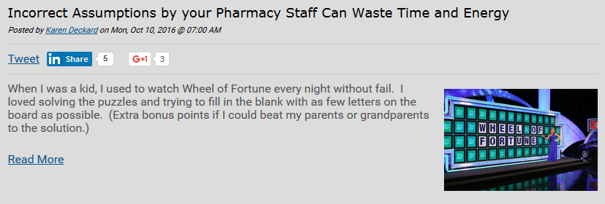
Surefire Growth Strategies For POS Resellers
PaymentsEdge Advisory Services
Content Marketing
www.rm-solutions.com/blog
Notes:
Auto-Star partner RMS (Retail Management Solutions) blog

Slide 23
Surefire Growth Strategies For POS Resellers
PaymentsEdge Advisory Services
Content Marketing
Notes:
Auto-Star partner RMS (Retail Management Solutions) blog

Slide 24
Surefire Growth Strategies For POS Resellers
PaymentsEdge Advisory Services
Content Marketing
www.rm-solutions.com/blog
Notes:
Auto-Star partner RMS (Retail Management Solutions) blog

Slide 25
Surefire Growth Strategies For POS Resellers
PaymentsEdge Advisory Services
Candid Customer Conversations
Clear agreements/SLAs
Customer Health Checkup + QBR
WCWBDB4U?
Commercial Teaching
Notes:
Never had a client bite, never had a customer punch (Ainsworth story)
Press 8
Press 9
Clear agreements/SLAs
Customer Health Checkup + QBR
Customer survey: Questions, independent source, candid interviews
QBR (Quarterly Business Review) with as many as appropriate
Ask all WCWBDB4U?

Slide 26
Questions?
Notes:
Before I offer my conclusion, I’m happy to answer any questions

Slide 27
Surefire Growth Strategies For POS Resellers
PaymentsEdge Advisory Services
1. Ramp up sales force
2. Add products/services
3. Enter new markets
4. Aggressive marketing
Notes:
Another $10,000 adding a real 4th reseller
Turn over worksheets
In that blank write the name of your company
Homework: step back, adopt these strategies, make your company a strong investment

Slide 28
Jim Roddy
Reseller & ISV Business Advisor
Jim.Roddy@vantiv.com
814.520.6342
@Jim_Roddy
Notes:
Copy of slide deck – call, email, or tweet
Thank you & and I wish you success growing your business.

